Slide 1
Topic 9: Data Analysis, Interpretation and Presentation
SECV2113 Human-Computer Interaction
Faculty of Computing
Universiti Teknologi Malaysia

Slide 2
Goals
Discuss the difference between qualitative and quantitative data and analysis
Enable you to analyse data gathered from:
  Questionnaires
  Interviews
  Observation studies
Make you aware of software packages that are available to help your analysis
Identify common pitfalls in data analysis, interpretation, and presentation
Enable you to interpret and present your findings in a meaningful and appropriate manner

Slide 3
QUANTITATIVE AND QUALITATIVE
01
BASIC QUANTITATIVE ANALYSIS
02
BASIC QUALITATIVE ANALYSIS
03
ANALYTICAL FRAMEWORKS
04
TOOLS TO SUPPORT DATA ANALYSIS
05
INTERPRETING AND PRESENTING FINDINGS
06

Slide 4
QUANTITATIVE AND
QUALITATIVE

Slide 5
Quantitative and Qualitative
Quantitative data: Expressed as numbers
Qualitative data: In the form of words and images. Can be expressed as numbers, but not always meaningful to do so
Quantitative analysis: Numerical methods to ascertain size, magnitude, or amount
Qualitative analysis: Expresses the nature of elements and is represented as themes, patterns, or stories
Be careful how you manipulate data and numbers!

Slide 6
BASIC QUANTITATIVE ANALYSIS

Slide 7
Basic Quantitative Analysis
Averages:
  Mean: Add up values and divide by number of data points
  Median: Middle value of data when ranked
  Mode: Value that appears most often in the data
Percentages
Be careful not to mislead with numbers!
Graphical representations give overview of data

Slide 8
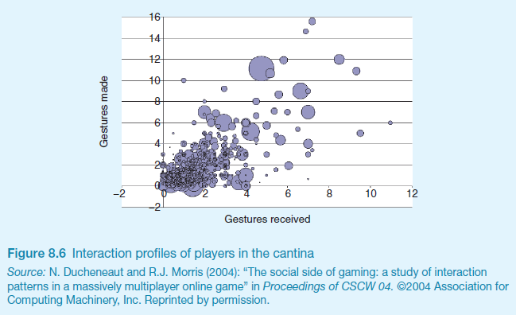
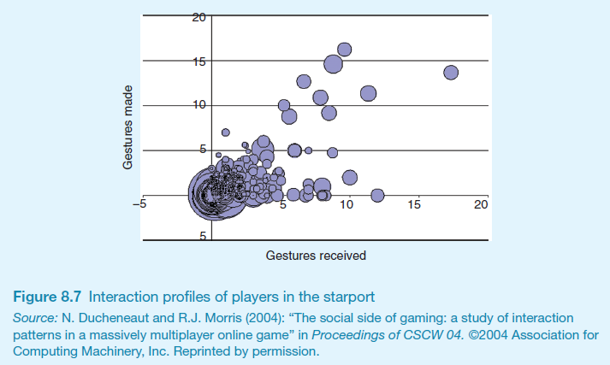
Visualising Log Data
Interaction profiles of players in online game
Log of web page activity

Slide 9
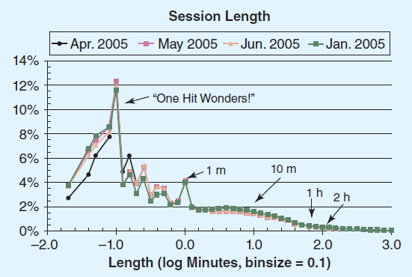
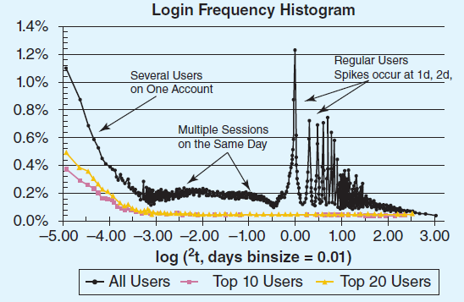
Web Analytics

Slide 10
Question Design Affects Data Analysis
Open question: Each answer analysed separately
Closed question: Can be analysed quantitatively
Fixed alternative answers restrict what can be said in findings

Slide 11
BASIC QUANTITATIVE ANALYSIS

Slide 12
Basic Qualitative Analysis
Coding is central to qualitative analysis
  Inductive (bottom-up) and Deductive (top-down)
  Meaningful codes that don’t overlap
  What level of granularity is appropriate?
Identifying themes
  Emergent from data, dependent on observation framework if used
  Inductive analysis
Categorising data
  Categorisation scheme pre-specified
  Deductive analysis
Combination of inductive and deductive is common

Slide 13
QUALITATIVE ANALYSIS ANALYTICAL FRAMEWORKS

Slide 14
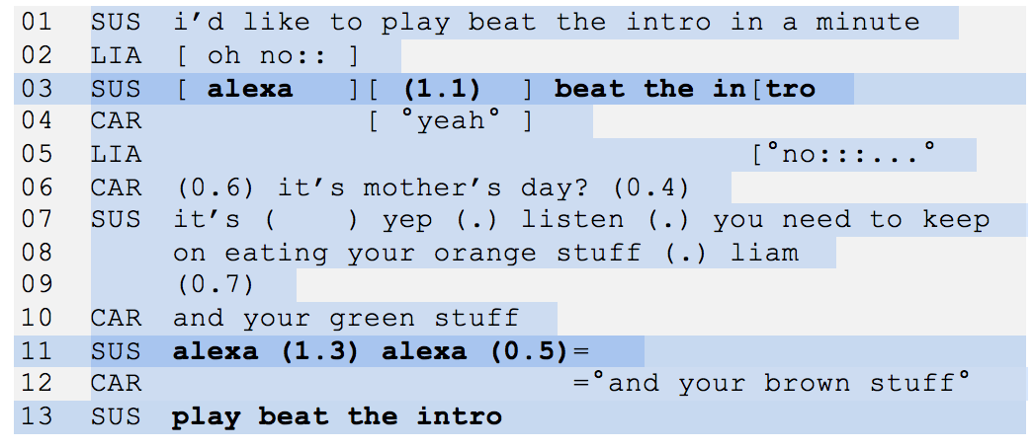
Conversation Analysis
Examines the semantics of a conversation in fine detail
An extract of the conversation between a family and Alexa

Slide 15
Discourse Analysis
Focuses on dialogue; that is, the meaning of what is said and how words convey meaning
Assumption that there is no objective scientific “truth”
Language is viewed as a constructive tool
Discourse analysis is useful when trying to identify subtle meaning
Time-consuming but tools can help as long as context isn’t lost

Slide 16
Content Analysis
Involves classifying data into themes or categories and studying their frequencies
Can be used for any “text”: video, newspapers, advertisements, images, and sounds
Often used in conjunction with other techniques

Slide 17
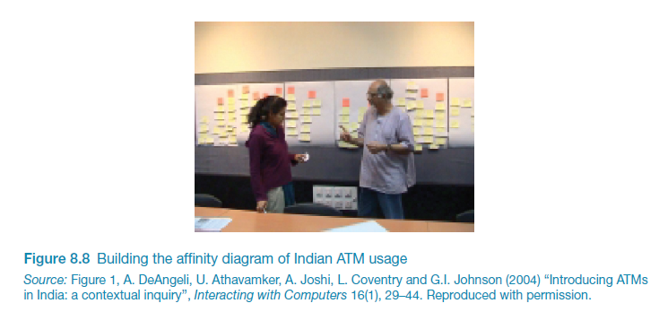
Simple Qualitative Analysis
17

Slide 18
Interaction Analysis
A way to investigate and understand interactions between people and between people and artefacts
Based on empirical observations such as videos
Inductive process in teams, collaboratively
Contents of the material is logged
Materials are extracted, classified, or removed
Instances of a salient event are assembled and played one after the other
The team of researchers studies the assemblage together

Slide 19
Grounded Theory
Seeks to develop theory from systematic analysis of empirical data
Three levels of coding
  Open: Identify categories
  Axial: Flesh out and link to subcategories
  Selective: Form theoretical scheme
Researchers are encouraged to draw on their own theoretical backgrounds to inform analysis
Analytic tools to help stimulate thinking:
  Question the data
  Analyse words, phrases or sentence
  Comparisons between objects or abstract categories

Slide 20
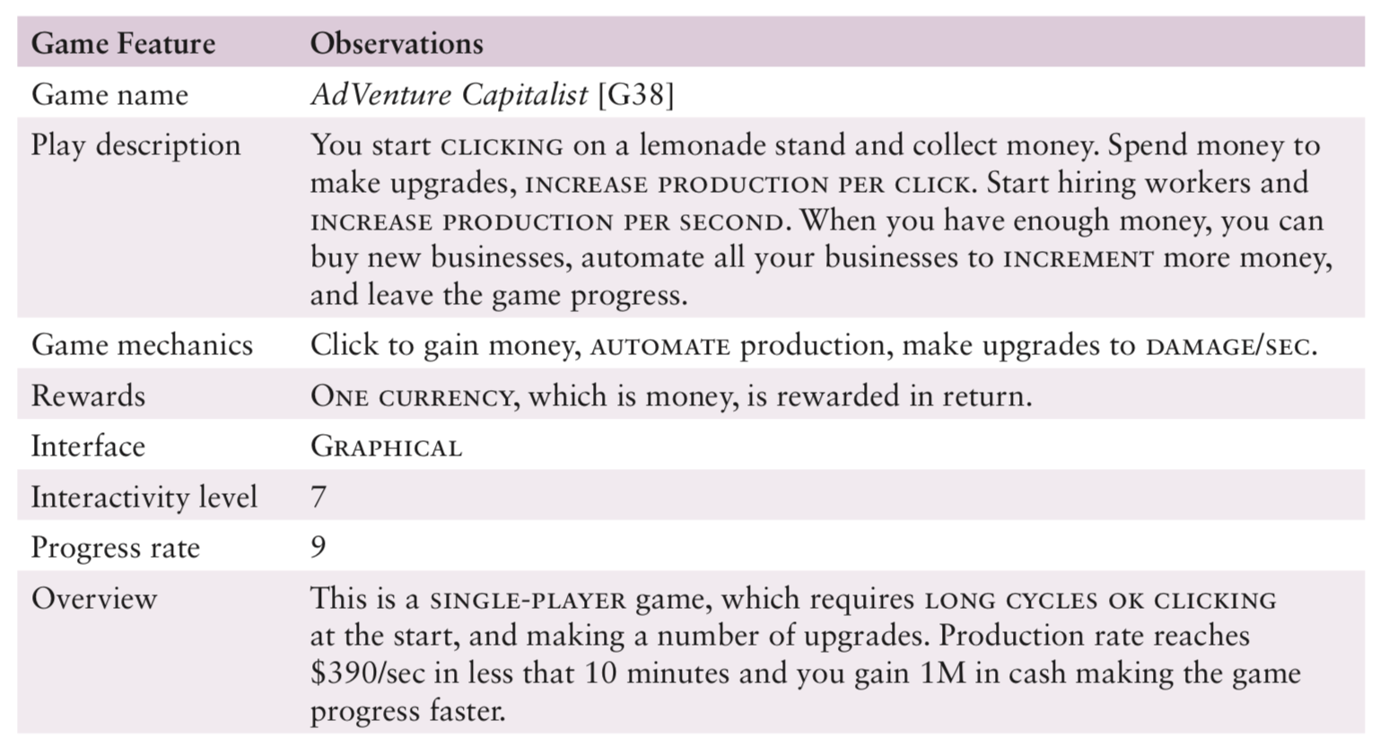
Illustration of Open Coding

Slide 21
Development of Open Coding
Source: Alharti et al (2018)

Slide 22
System-based Frameworks
Understanding a whole socio-technical system requires different analytical framework
Socio-technical Systems Theory
Distributed Cognition of Teamwork
Source: Zaina et al. (2021)

Slide 23
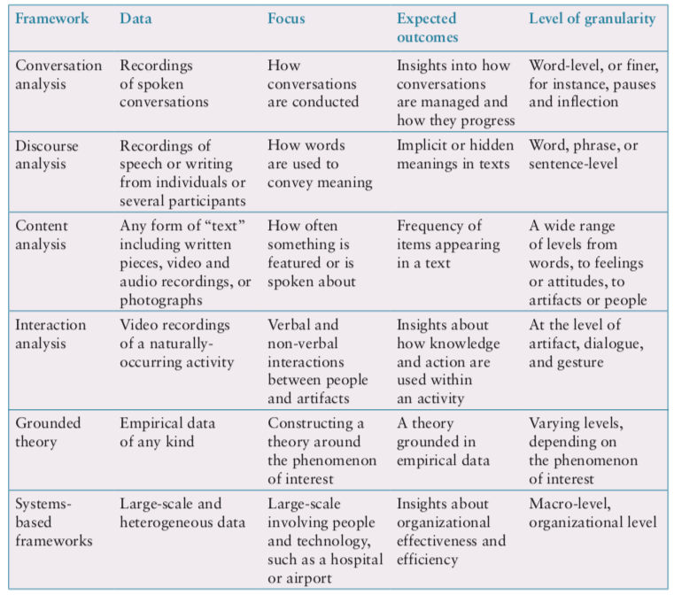
Which Analytical Framework?
23

Slide 24
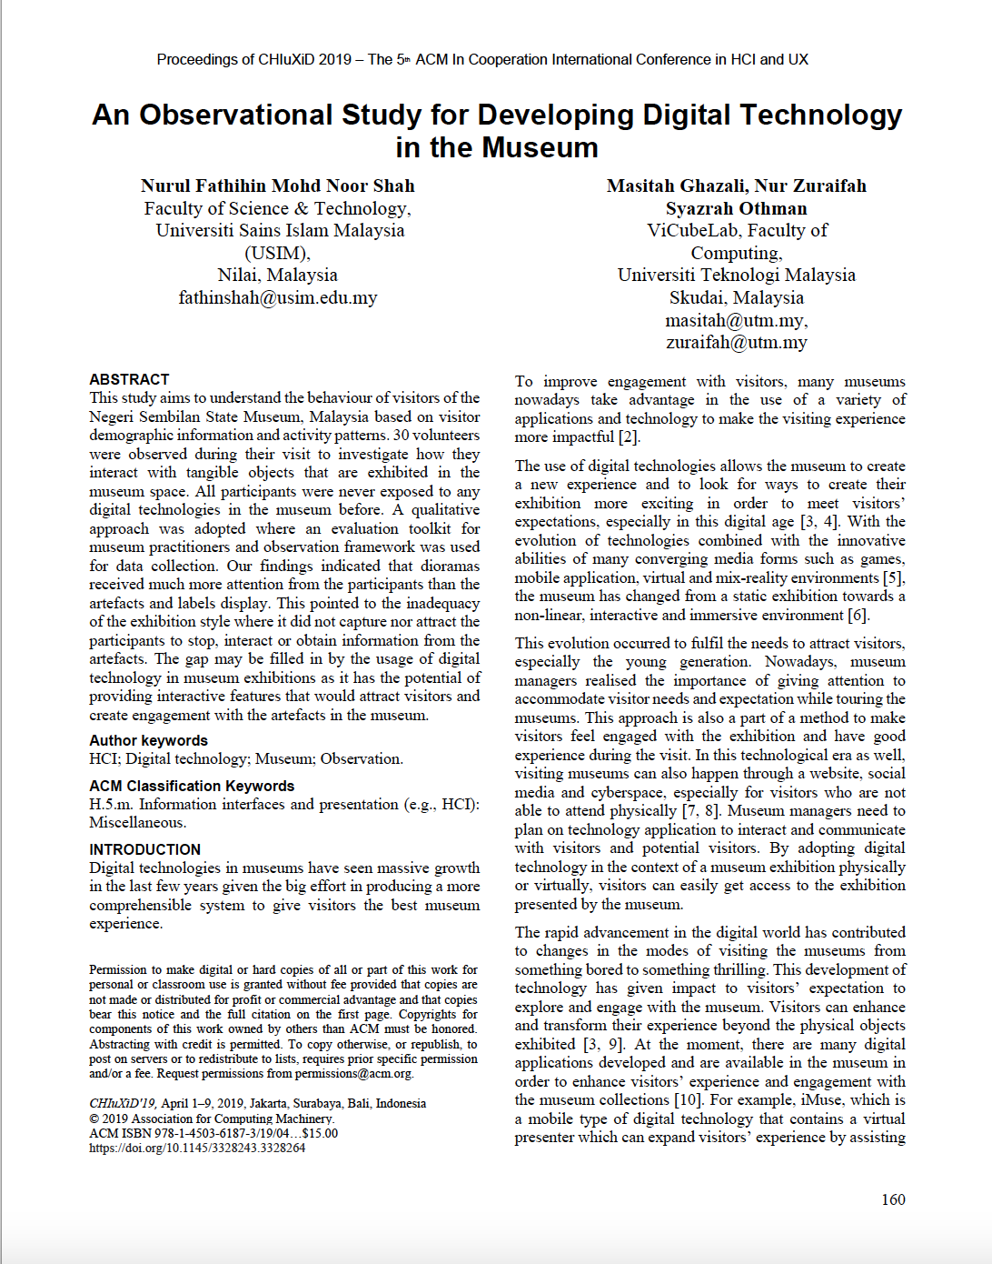
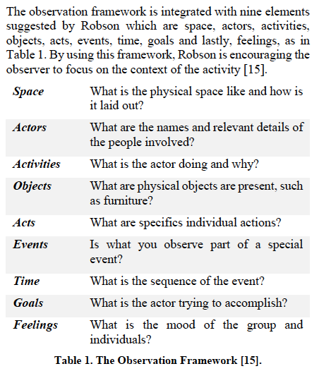
Method used

Slide 25
TOOLS TO SUPPORT DATA ANALYSIS

Slide 26
Tools Support
Spreadsheet — Simple to use, basic graphs
Statistical packages, for example, R and SPSS
Qualitative data analysis tools
  Categorisation and theme-based analysis
  Quantitative analysis of text-based data
Nvivo and Dedoose support qualitative data analysis
Computer Assisted Qualitative Data Analysis (CAQDAS) Networking Project, based at the University of Surrey

Slide 27
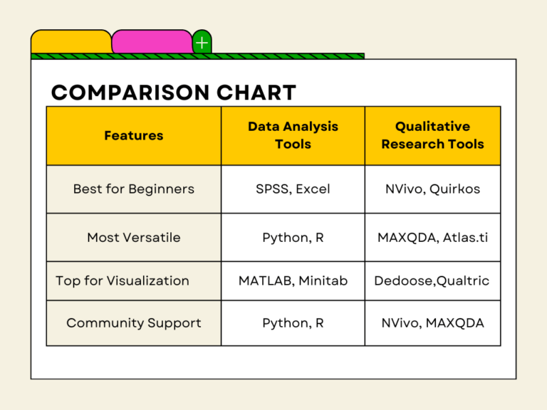
Tools Support (Cont.)
Source: https://www.smartresearcher.me/phd-students-20-tools-for-qualitative-and-quantitative-research/

Slide 28
Tools Support (Cont.)
Quantitative data analysis tools:
https://contentsquare.com/guides/quantitative-data-analysis/software/
https://www.ibm.com/products/spss-statistics
https://www.mathworks.com/products/matlab.html
Qualitative data analysis tools:
https://lumivero.com/products/nvivo/
https://www.maxqda.com/
https://www.dedoose.com/

Slide 29
INTERPRETING AND PRESENTING FINDINGS

Slide 30
Bubble Chart of Media Networking Tools
Source: https://www.zoho.com/analytics/data-visualization-software/bubble-chart-maker.html

Slide 31
Q. What time of day do people use their phones most?
A. The snooze button might be what’s behind all the predawn activity we saw. But at 7AM, touches explode, ramping up almost continuously until dinner time.
Source: https://medium.com/peoplenerds/putting-a-finger-on-our-phone-obsession-d65734181dc7

Slide 32
Presenting Findings
Structured notations have clear syntax and semantics to present particular viewpoint
Using stories is an easy and intuitive approach to communicate ideas
Summarise findings using a range of notations

Slide 33
Key Points
The data analysis that can be done depends on the data gathering technique(s) used
Qualitative and quantitative data may be gathered from any of the three main data gathering approaches
Percentages and averages are commonly used in Interaction Design
Graphical representations help to identify patterns and outliers
Mean, median, and mode are different kinds of ‘average’ and can have very different answers for the same set of data
Analysis of qualitative data analysis may be inductive (extracted from the data), or deductive (pre-existing concepts)
Several analytical frameworks exist that focus on different levels of granularity with different purposes

